Slide 1
Creating a Bootstrap-enabled Form

Slide 2

Overview
Exploring the form in Bootstrap
Applying style on the form controls

Slide 3
Exploring the Form in Bootstrap

Slide 4
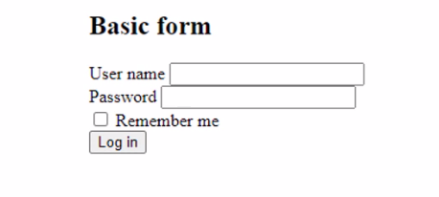
Adding Bootstrap to a Form

Slide 5
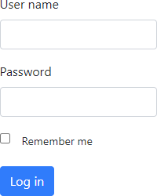
Basic Layout of the Form
<form>
<div class="form-group">
<label for="userNameInput"> User name
</label>
<input type="text" class="form-control"
id="userNameInput">
</div>
</form>

Slide 6
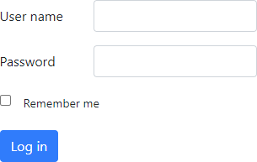
Horizontal Layout
<form>
<div class="form-group row ">
<label for="userNameInput"
class=" col-sm-4 col-form-label"> User name
</label>
<div class="col-sm-8">
<input type="text" class="form-control" id="userNameInput">
</div>
</div>
</form>

Slide 7
Inline Forms
<form class="form-inline">
<div class="form-group">
<label for="userNameInput" class="mr-2"> User name
</label>
<input type="text" class="form-control mr-2" id="userNameInput">
</div>
</form>

Slide 8

Demo
Working with form layouts

Slide 9
Applying Style on the Form Inputs

Slide 10
<input type="text" class="form-control" id="userNameInput">
<select class="form-control" id="countrySelect">
<textarea class="form-control" id="commentTextArea" rows="3"></textarea>
Using form-control

Slide 11
<input type="text" class="form-control form-control-lg" id="userNameInput">
Sizing the Control
lg or sm exist

Slide 12
<input type="range" class="form-control-range">
<input type="checkbox" class="form-check-input" >
Other Control Classes

Slide 13
Working with input-group
<div class="input-group">
<div class="input-group-prepend">
<span class="input-group text" id="userNameAddon">@</span>
</div>
<input type="text" class="form-control“ placeholder="Email">
</div>

Slide 14
Demo
Adding the form input styles

Slide 15
Demo
Creating the order form

Slide 16
Summary
Form components allow for rich and great-looking forms on a web page
Again plain CSS classes

Slide 17


Up next:
Working with interactive components

